Slide 1
Classical mechanics as the high-entropy limit of quantum mechanics
Gabriele Carcassi¹, Manuele Landini² and Christine A. Aidala¹
¹Physics Department University of Michigan
²Institut für Experimental Physik und Zentrum für Quantenphysik, Universität Innsbruck

Slide 2


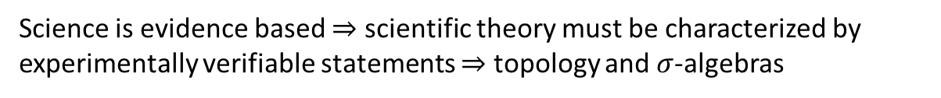

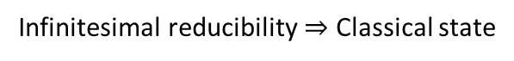
Main goal of the program
Identify a handful of physical starting points from which the basic laws can be rigorously derived
For example:
Infinitesimal reducibility $⇒$ Classical state
Irreducibility $⇒$ Quantum state
https://assumptionsofphysics.org
?
time
time
This also requires rederiving all mathematical structures from physical requirements
For example:
Science is evidence based $⇒$ scientific theory must be characterized by experimentally verifiable statements $⇒$ topology and $σ$-algebras

Slide 3
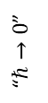
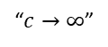
Low speed
Speed
“$c→∞$”
Classical Mechanics | Relativistic Mechanics
Quantum Mechanics | Quantum Field Theory
“$ℏ→0$”
???
Not about size or number of particles!
Coherent communication over 254 Km https://phys.org/news/2025-04-quantum-messages-km-infrastructure.html
A billion hydrogen atoms in a single Bose–Einstein Condensate https://doi.org/10.1016/S0921-4526(99)01415-5

Slide 4
Why does classical mechanics fail, and how is it fixed by quantum mechanics?
When can I use classical mechanics, and when can’t I?
What are the rules?!?

Slide 5

It’s Always Sunny in Philadelphia

Slide 6
Why does classical mechanics fail, and how is it fixed by quantum mechanics?
When can I use classical mechanics, and when can’t I?
What are the rules?!?

Slide 7
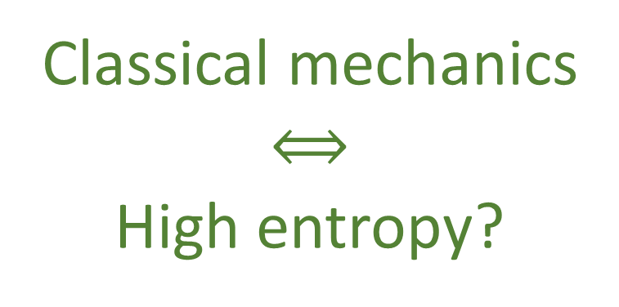
Let’s review some cases and see if we can find common ground
For massive particles moving in an electromagnetic field, you often can use classical mechanics
Sometimes coherence (and therefore quantum effects) can be lost through interaction with environment (decoherence)
Low precision description means high entropy
Environment introduces entropy in the system
Classical mechanics
$$⟺$$
High entropy?
For Bose Einstein Condensates you need high density in phase space
Superconductivity can be achieved at high temperature and high pressure
High phase space density means low entropy
High pressure means low entropy
High temperature means high entropy
Many quantum effects are difficult/impossible to achieve at high temperature
(e.g. superconductivity, topological insulators, quantum Hall effect, …)

Slide 8
What’s the problem with classical mechanics and low entropy?

Slide 9
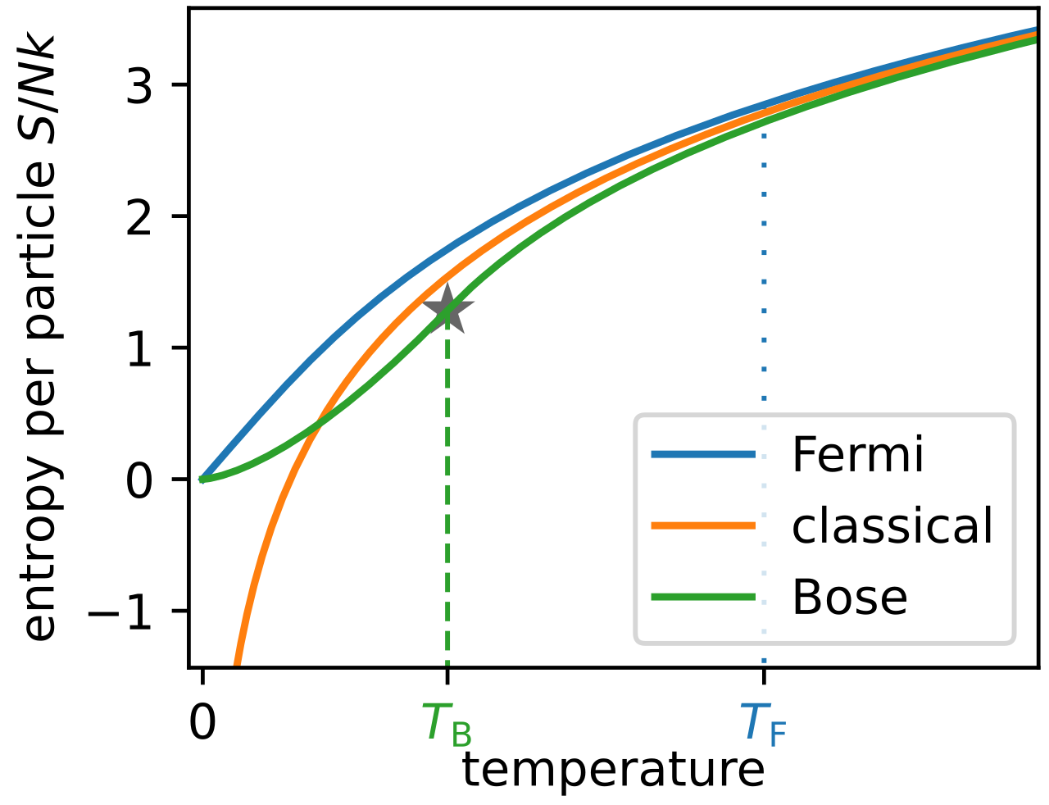
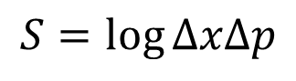
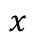
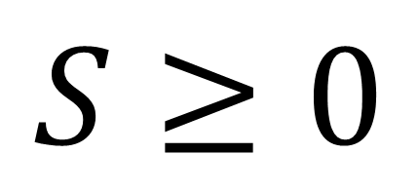
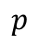
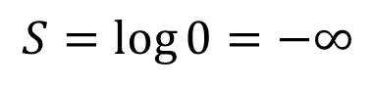
Wikipedia
Third law of thermodynamics
Temperature/entropy curve for ideal gases
to minus infinity!
Every substance has a finite positive entropy, but at the absolute zero of temperature the entropy may become zero, and does so become in the case of perfect crystalline substances.
$$p$$
G. N. Lewis and M. Randall, Thermodynamics and the
free energy of chemical substances (McGraw-Hill, 1923)
$$S≥0$$
$$S=\log{ΔxΔp}$$
$$x$$
For a single microstate
$$S=\log{0}=−∞$$
Classical physics allows arbitrarily small entropy…
… but thermodynamics doesn’t!!!

Slide 10

Well, there’s your problem!
Adam Savage - Mythbusters

Slide 11
Wikipedia
Third law of thermodynamics
Temperature/entropy curve for ideal gases
to minus infinity!
Every substance has a finite positive entropy, but at the absolute zero of temperature the entropy may become zero, and does so become in the case of perfect crystalline substances.
$$p$$
G. N. Lewis and M. Randall, Thermodynamics and the
free energy of chemical substances (McGraw-Hill, 1923)
$$S≥0$$
$$S=\log{ΔxΔp}$$
$$x$$
For a single microstate
$$S=\log{0}=−∞$$
Classical physics allows arbitrarily small entropy…
… but thermodynamics doesn’t!!!

Slide 12
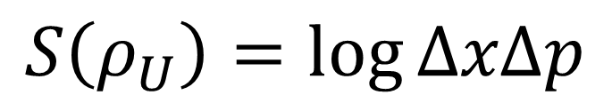
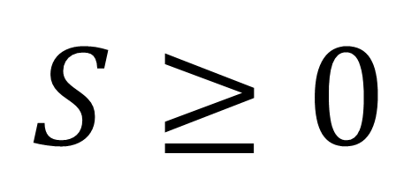
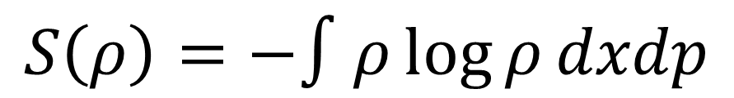
Third law of thermodynamics
$$S≥0$$
$$p$$
There is a lower bound on the entropy
Statistical mechanics
$$x$$
$$S\left(ρ_{U}\right)=\log{ΔxΔp}$$
Dimensionally incorrect!!!
$$S\left(ρ\right)=−∫ρ\log{ρ}dxdp$$

Slide 13

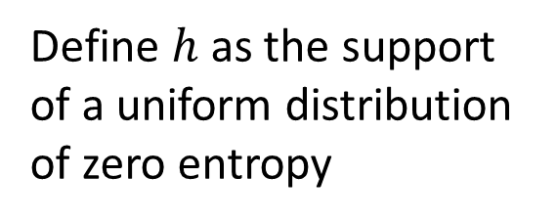
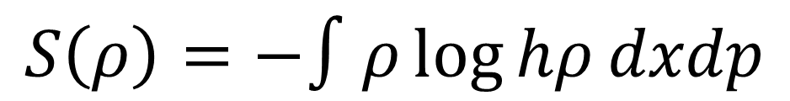
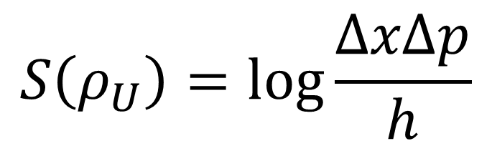
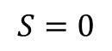
previous results
Third law of thermodynamics
$$S≥0$$
$$p$$
$$S=0$$
There is a lower bound on the entropy
$$h$$
Statistical mechanics
$$x$$
$$S\left(ρ_{U}\right)=\log{\frac{ΔxΔp}{h}}$$
Define $h$ as the support of a uniform distribution of zero entropy
$$S\left(ρ\right)=−∫ρ\log{hρ}dxdp$$
Fixes units (i.e. log argument is a pure number) and zero of entropy

Slide 14
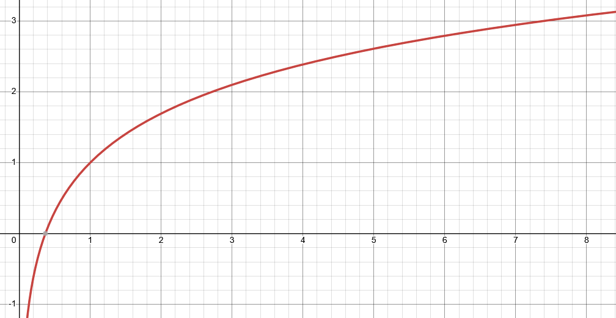
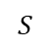
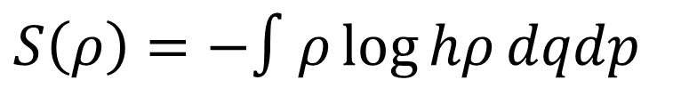
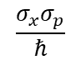
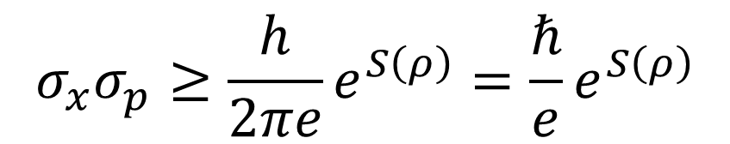
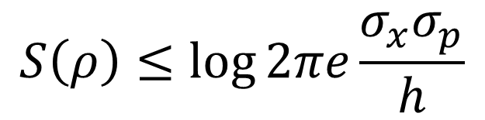
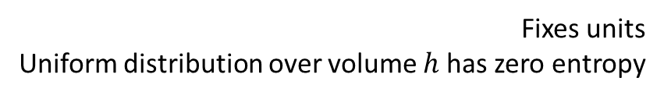
Entropy vs uncertainty
$S\left(ρ\right)=−∫ρ\log{hρ}dqdp$
Let’s plot one against the other
Fixes units Uniform distribution over volume $h$ has zero entropy
$$S$$
Gaussian maximizes entropy for a given uncertainty
excluded by gaussian bound
$$S\left(ρ\right)≤\log{2πe\frac{σ_{x}σ_{p}}{h}}$$
$$σ_{x}σ_{p}≥\frac{h}{2πe}e^{S\left(ρ\right)}=\frac{ℏ}{e}e^{S\left(ρ\right)}$$
$$\frac{σ_{x}σ_{p}}{ℏ}$$
Entropy puts a lower bound on the uncertainty
But the third law imposes a lower bound on the entropy!

Slide 15
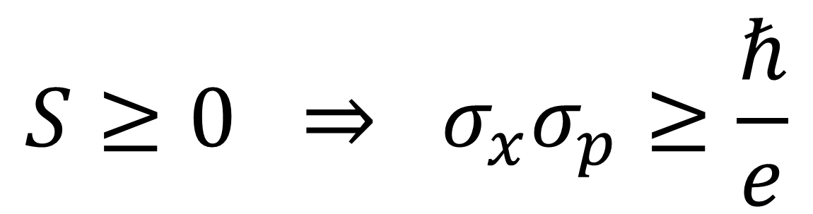
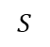
With the 3rd law
$$S$$
excluded by gaussian bound
Every substance has a finite positive entropy, but at the absolute zero of temperature the entropy may become zero, and does so become in the case of perfect crystalline substances.
G. N. Lewis and M. Randall, Thermodynamics and the
free energy of chemical substances (McGraw-Hill, 1923)
$$\frac{σ_{x}σ_{p}}{ℏ}$$
excluded by 3rd law of thermodynamics
$$S≥0 ⇒ σ_{x}σ_{p}≥\frac{ℏ}{e}$$
Classical uncertainty principle

Slide 16
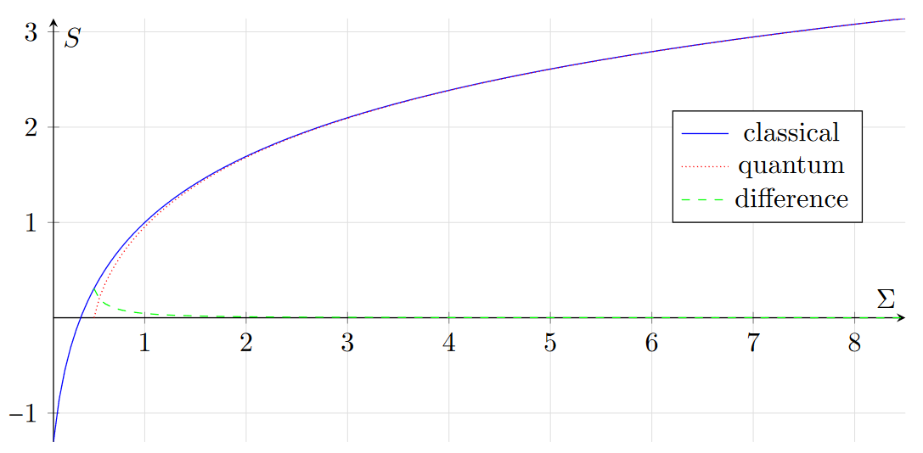
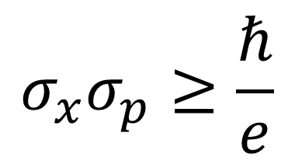
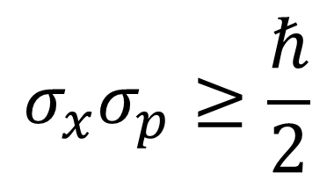
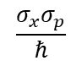
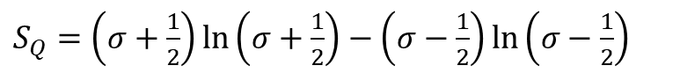
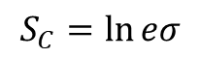
Comparing theories
excluded by gaussian bound
$$σ_{x}σ_{p}≥\frac{ℏ}{e}$$
$$σ_{x}σ_{p}≥\frac{ℏ}{2}$$
classical
quantum
$$\frac{σ_{x}σ_{p}}{ℏ}$$
2.71828…
excluded by 3rd law of thermodynamics
Entropy of quantum states is already non-negative
$$S_{C}=\ln{eσ}$$
The gaussian bound quickly becomes very similar across theories
$S_{Q}=\left(σ+\frac{1}{2}\right)\ln\left(σ+\frac{1}{2}\right)−\left(σ−\frac{1}{2}\right)\ln\left(σ−\frac{1}{2}\right)$
Quantum mechanics incorporates the third law Classical mechanics does not
Looks like: quantum and classical mechanics only differ at low entropy

Slide 17
Is classical mechanics recovered at high entropy? Why?

Slide 18
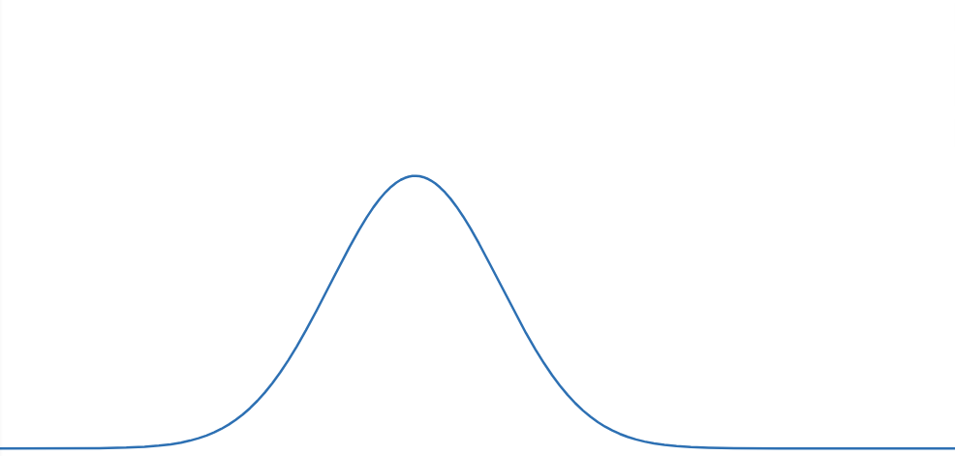
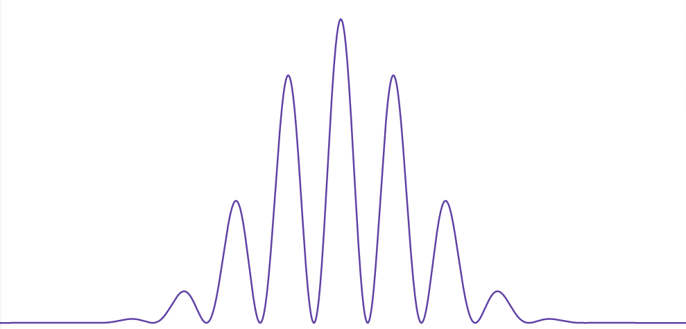
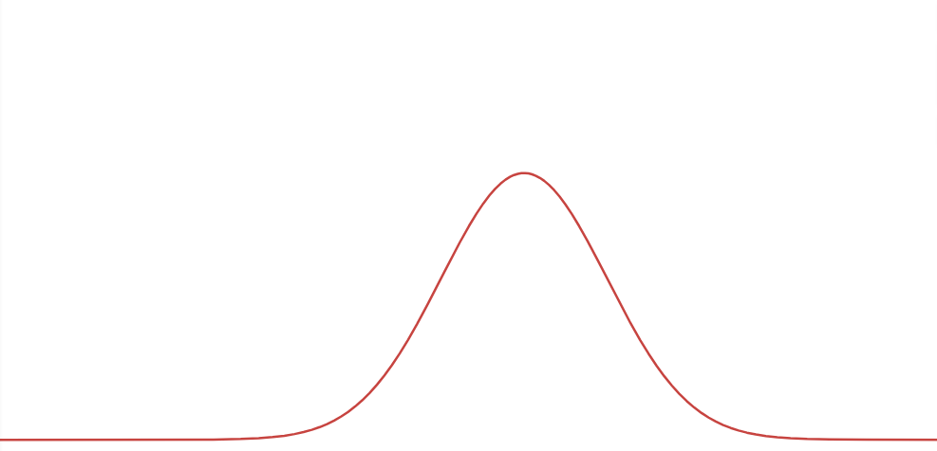
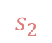
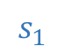
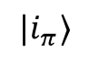
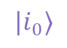
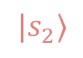
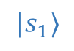
We can open one slit at a time (path is a classical variable)
Interference cannot be understood as statistical mixture of single slit open (phase difference is a quantum variable)
$$|s_{1}⟩$$
$$|i_{π}⟩$$
$$|i_{0}⟩$$
$$s_{1}$$
$$s_{2}$$
$$|s_{2}⟩$$
“Quantum variables” cannot be described by “classical variables”

Slide 19
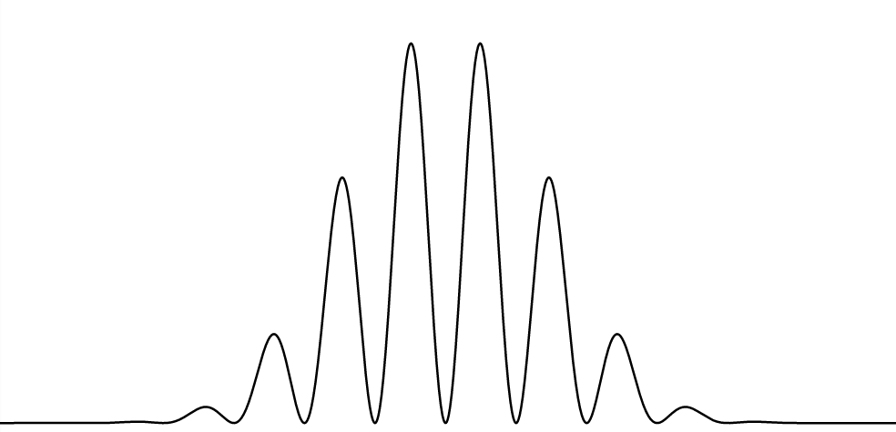
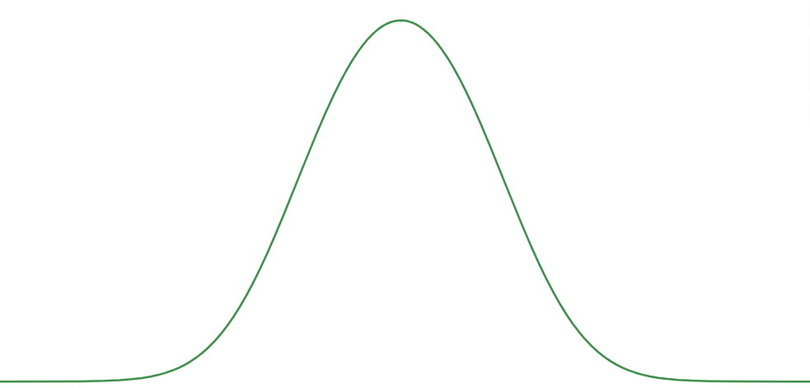
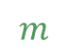
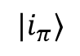
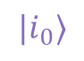
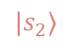
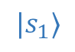
Maximally mixed state obtained by uncertainty on the open slit (uncertainty on classical variable)
Maximally mixed state obtained by uncertainty on the phase difference (quantum variable)
$$|s_{1}⟩$$
$$|i_{π}⟩$$
$$m$$
$$|i_{0}⟩$$
$$s_{1}$$
$$s_{2}$$
$$|s_{2}⟩$$
Uncertainty on “quantum variables” can be represented by uncertainty on “classical variables”

Slide 20
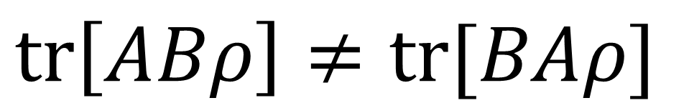

Mathematically, operators do not commute in general:
$$tr\left[ABρ\right]≠tr[BAρ]$$
But they “commute” for the maximally mixed state $ρ=I/n$:
$$tr\left[AB I/n\right]=tr\left[B I/n A\right]=tr[BA I/n]$$
$ρ$ commutes with both $A$ and $B$ $⇒$ $\left\langle AB\right\rangle =\left\langle BA\right\rangle$
Both observables are well-defined

Slide 21


As you increase entropy, the error you make approximating to a mixture of eigenstates of any observable decreases
$$|s_{1}⟩$$
Conjecture: this works in infinite dimensions, where there is no maximally mixed state
$$|i_{π}⟩$$
$$|i_{0}⟩$$
As you increase entropy, you can approximate your mixed state as commuting with both position and momentum
$$|s_{2}⟩$$
How do you prove it?

Slide 22



06/01/2024

Slide 23
Reinterpret old results

Slide 24



Classical blackbody radiation recovered at small frequencies
At thermal equilibrium, high entropy $⇔$ high temperature $⇔$ low $β$
Classical blackbody radiation recovered at small $β$

Slide 25



Wigner function of a thermal state
Classical distribution is the leading term of expansion in $ℏ$
At thermal equilibrium, high entropy $⇔$ high temperature $⇔$ low $β$
We recover the same limit and correction with a more meaningful expansion in $β$

Slide 26
High entropy limit

Slide 27







Looking for a map $R(ρ)$ that increases entropy of all mixed states, such that every level set of entropy maps to another level set
$$S$$
$⇒$ Unitary trans. must be mapped to unitary trans.
excluded by gaussian bound
$R\left(ρ\right)$ Entropy increasing map
Unitary map
$$\frac{σ_{x}σ_{p}}{ℏ}$$
excluded by 3rd law of thermodynamics
classical
quantum
$$\left[X,P\right]=ıℏ⇒$$
$$\left[T\left(X\right),T\left(P\right)\right]=λıℏ$$

Slide 28







Entropy increasing maps in classical mechanics
We want a map $\left(x,p\right)↦(\hat{x},\hat{p})$ that increases the entropy of all distributions by the same value
$$S\left[ρ\left(x,p\right)\right]=−\int{ρ\log{ρ}dxdp}=−\int{\hat{ρ}\left|J\right|\log\left(\hat{ρ}\left|J\right|\right)}dxdp$$
$$=−\int{\hat{ρ}}\log\left(\hat{ρ}\left|J\right|\right)d\hat{x}d\hat{p}$$
$$=−\int{\hat{ρ}\log{\hat{ρ}}d\hat{x}d\hat{p}}−\int{\hat{ρ}\log\left|J\right|d\hat{x}d\hat{p}}$$
$$=S\left[\hat{ρ}\left(\hat{x},\hat{p}\right)\right]−\int{\hat{ρ}\log\left|J\right|d\hat{x}d\hat{p}}$$
Poisson bracket!
$⇒$ Jacobian determinant must be a constant!
$$\frac{∂\hat{x}}{∂x}\frac{∂\hat{p}}{∂p}−\frac{∂\hat{x}}{∂p}\frac{∂\hat{p}}{∂x}=λ$$
$$S\left[R\left(ρ\right)\right]=S\left[ρ\right]+\log{λ}$$

Slide 29

Entropy increasing maps in classical mechanics
$$S\left[R\left(ρ\right)\right]=S\left[ρ\right]+\log{λ}⟺\left\{R\left(x\right),R\left(p\right)\right\}=λ\{x,p\}$$
Let’s call “stretching maps” those $R$ that satisfy this property
Let’s call “pure stretching map” the map $T$ such that $\left(x,p\right)↦\left(\sqrt{λ} x,\sqrt{λ} p\right)$
They also satisfy
$$\left\langle T\left(x^{n}p^{m}\right)\right\rangle ={\left(\sqrt{λ}\right)}^{n+m}\left\langle x^{n}p^{m}\right\rangle$$

Slide 30

In classical mechanics
$$S\left(R\left(ρ\right)\right)=S\left(ρ\right)+\log{λ}⟺\left\{R\left(x\right),R\left(p\right)\right\}=λ\{x,p\}$$
In quantum mechanics
Jacobian determinant is a constant: all volumes rescaled by the same factor
Stretching map
$$\left[R\left(X\right),R\left(P\right)\right]=λ\left[X,P\right]$$
Stretching maps can’t be a unitary transformation
They do not conserve entropy nor preserve commutation relationship
They must be quantum channels
They are maps between density matrices, not pure states

Slide 31

Linblad master equation for open quantum systems
Infinitesimal stretching map must obey
$$\frac{dX}{dt}=\frac{ı}{ℏ}\left[H,X\right]+γ\left(L^{†}XL−\frac{1}{2}\left\{L^{†}L,X\right\}\right)$$
Unitary/conservative part
Non-unitary/non-conservative part

Slide 32




Quantum pure stretching map
$$T\left(X\right)=\sqrt{λ} X$$
$$T\left(P\right)=\sqrt{λ} P$$
What about products?
Only unitary maps preserve products!
1. Suppose $T\left(ρ_{1}ρ_{2}\right)=T\left(ρ_{1}\right)T(ρ_{2})$. Since pure states are exactly the density matrices for which $ρ^{2}=ρ$, $T\left(ρ\right)=T\left(ρ^{2}\right)=T\left(ρ\right)T\left(ρ\right)=T{\left(ρ\right)}^{2}$ and therefore $T$ maps pure states to pure states. Therefore, it is a unitary map! 2. Suppose $T\left(AB\right)=T\left(A\right)T\left(B\right)$. Then $T\left(\left[A,B\right]\right)=T\left(AB\right)−T\left(BA\right)=\left[T\left(A\right),T\left(B\right)\right]$
Which product ordering recovers $\left\langle T\left(x^{n}p^{m}\right)\right\rangle ={\left(\sqrt{λ}\right)}^{n+m}\left\langle x^{n}p^{m}\right\rangle$?

Slide 33



Symmetrized operator averages
Wikipedia
We take the average of all permutations
Also given by the expectations of the Wigner function
A stretching map that rescales symmetrized operator averages is a stretching map in phase space for the Wigner function…
… and it can’t work!!!

Slide 34
Symmetrized operator averages
Wigner functions can have negative values, but they must be restricted to “small” regions
A stretching map would make those regions arbitrarily large, so it can’t map valid quantum states to valid quantum states
Wikipedia
Symmetrized operator averages are ruled out!

Slide 35




Normal ordering
$$a=\sqrt{\frac{mω}{2ℏ}}\left(X+\frac{ı}{mω}P\right)$$
$$a^{†} =\sqrt{\frac{mω}{2ℏ}}\left(X+\frac{ı}{mω}P\right)$$
For the vacuum state we have $a\left|0\right\rangle =0$. The mean for all expectations for the vacuum state is zero. Therefore, after the map, all expectations are zero. Which means the vacuum is mapped to the vacuum. Entropy is not increased for all states!
Normal ordering is ruled out!

Slide 36




Anti-normal ordering
$$a=\sqrt{\frac{mω}{2ℏ}}\left(X+\frac{ı}{mω}P\right)$$
$$a^{†} =\sqrt{\frac{mω}{2ℏ}}\left(X+\frac{ı}{mω}P\right)$$
Also given by the expectations of the Husimi Q function
$T_{Q}$ stretches the Husimi Q…
… which is non-negative!!!
Maurice de Gosson

Slide 37










So, we want:
Lindblad master equation
$$\frac{dX}{dt}=\frac{ı}{ℏ}\left[H,X\right]+γ\left(L^{†}XL−\frac{1}{2}\left\{L^{†}L,X\right\}\right)$$
We set
$$H=0$$
$$L=a^{†}$$
Recall $\left[a,a^{†}\right]=1$
$$\left[a,{\left(a^{†}\right)}^{m}\right]=m{\left(a^{†}\right)}^{m−1}$$
$$\frac{d}{dt}a^{n}{\left(a^{†}\right)}^{m}=γ\left(aa^{n}{\left(a^{†}\right)}^{m}a^{†}−\frac{1}{2}aa^{†}a^{n}{\left(a^{†}\right)}^{m}−\frac{1}{2}a^{n}{\left(a^{†}\right)}^{m}aa^{†}\right)$$
$$\left[a^{n},a^{†}\right]=na^{n−1}$$
$$=γ\left(aa^{n}{\left(a^{†}\right)}^{m}a^{†}−\frac{1}{2}aa^{n}{\left(a^{†}\right)}^{m}a^{†}−\frac{1}{2}a\left[a^{†},a^{n}\right]{\left(a^{†}\right)}^{m}−\frac{1}{2}aa^{n}{\left(a^{†}\right)}^{m}a^{†}−\frac{1}{2}a^{n}\left[{\left(a^{†}\right)}^{m},a\right]a^{†}\right)$$
$$=γ\left(−\frac{1}{2}a\left(−na^{n−1}\right){\left(a^{†}\right)}^{m}−\frac{1}{2}a^{n}\left(−m{\left(a^{†}\right)}^{m−1}\right)a^{†}\right)$$
$${\left(\sqrt{λ}\right)}^{n+m}$$
$$=\frac{γ}{2}\left(n+m\right)a^{n}{\left(a^{†}\right)}^{m}$$
$$⇒\left(a^{n}{\left(a^{†}\right)}^{m}\right)\left(t\right)=e^{\frac{γ}{2}t\left(n+m\right)}a^{n}{\left(a^{†}\right)}^{m}$$
first-order linear ODE

Slide 38


Effects of stretching map on phase space representations
Husimi Q is simply stretched
Wigner function is stretched and convolved with a gaussian, and coincides with the Husimi Q in the limit $λ→∞$

Slide 39

Stretching a cat state
Wikipedia

Slide 40

Recover $ℏ→0$

Slide 41






Physical limit: entropy of mixed state is high
$S≫0$
Mathematical limit:
entropy of pure states is minus infinity
$ℏ→0$
$$S$$
excluded by gaussian bound
Unitary map
$$\frac{σ_{x}σ_{p}}{ℏ}$$
excluded by 3rd law of thermodynamics
In relativity
Physical limit: velocities are small $v≪c$
Mathematical limit: speed of light is infinite $c→+∞$

Slide 42













We started with
After the map, we found
$$X$$
$$P$$
$$T\left(X\right)$$
$$T\left(P\right)$$
$$\left[X,P\right]=ıℏ$$
$$\left[T\left(X\right),T\left(P\right)\right]=λıℏ$$
We want to start with
So that after the map we find
$$\hat{X}$$
$$\hat{P}$$
$$T\left(\hat{X}\right)$$
$$T\left(\hat{P}\right)$$
Therefore, we must have
$$\left[T\left(\hat{X}\right),T\left(\hat{P}\right)\right]=ıℏ$$
$$\left[\hat{X},\hat{P}\right]=\frac{ıℏ}{λ}$$
But $λ→∞ ⇒ \frac{ℏ}{λ}→0$

Slide 43
Low speed
Speed
“$c→∞$”
Classical Mechanics | Relativistic Mechanics
Quantum Mechanics | Quantum Field Theory
High entropy
“$ℏ→0$”
Entropy
No-mechanism limit (same as non-relativistic limit)

Slide 44

Meatballs

Slide 45
Low speed
Speed
“$c→∞$”
Classical Mechanics | Relativistic Mechanics
Quantum Mechanics | Quantum Field Theory
High entropy
“$ℏ→0$”
Entropy
No-mechanism limit (same as non-relativistic limit)

Slide 46
Can we say the converse? That quantization is putting a low entropy bound on a classical theory?

Slide 47

Suppose we ask for a theory with an entropic lower bound that recovers the classical one at high entropy
Moyal bracket is the unique one-parameter Lie-algebraic deformation of the Poisson bracket
Only one way to do it
$$\left\{A,B\right\}⟶\frac{\left[A,B\right]}{ıℏ}$$
Dirac’s correspondence principle
Quantizing a classical theory means putting a lower bound on the entropy

Slide 48

Assumptions of Physics: find a minimal set of physical assumptions from which the physical laws can be rigorously rederived
Logic of experimental verifiability $⇒$ topologies and $σ$-algebras
Real valued quantities recovered from a metrological model
Variability of elements within an ensemble $⇒$ entropy
Geometric structures $⇔$ entropic structures
Invariance of entropy across observers $⇒$ symplectic structure
Determinism/reversibility $⇔$ conservation of entropy $⇔$ Hamiltonian evolution
Geometric and physical interpretation of the action principle
Action is the line integral of the vector potential of the flow of states
Statistical mixing $⇒$ all linear structure in physics
…

Slide 49
More about our research program
Program website
https://assumptionsofphysics.org for papers, presentations, …
https://assumptionsofphysics.org/book for our open access book (updated every few years with new results)
YouTube channels
https://www.youtube.com/@gcarcassi Videos with results and insights from the research
https://www.youtube.com/@AssumptionsofPhysicsResearch Research channel, with open questions and livestreamed work sessions
GitHub
https://github.com/assumptionsofphysics Book, research papers, slides for videos...

Slide 51


Slide 52


Temperature/entropy curve for ideal gases
Entropy in phase space
$$p$$
$$S=\log{ΔxΔp}$$
$$x$$
For a single microstate
$$S=\log{0}=−∞$$
Classical mechanics allows arbitrarily large negative entropy!!!

Slide 53
Main goal of the project
Identify a handful of physical starting points from which the basic laws can be rigorously derived
For example:
Infinitesimal reducibility $⇒$ Classical state
Irreducibility $⇒$ Quantum state
https://assumptionsofphysics.org
?
time
time
This also requires rederiving all mathematical structures from physical requirements
For example:
Science is evidence based $⇒$ scientific theory must be characterized by experimentally verifiable statements $⇒$ topology and $σ$-algebras

